Slide 1
Вселенная мультсериала «Рик и Морти» на примере 15 эпизода
Подготовили:
Курдюмов Дмитрий
Галай Олеся

Slide 2


Что хотелось бы в идеале?
Best uncle ever!

Slide 3
Используемые данные
Тексты
Транскрипция реплик персонажей
Аудио
Реплики персонажей
Изображения
Кадр с говорящим

Slide 4
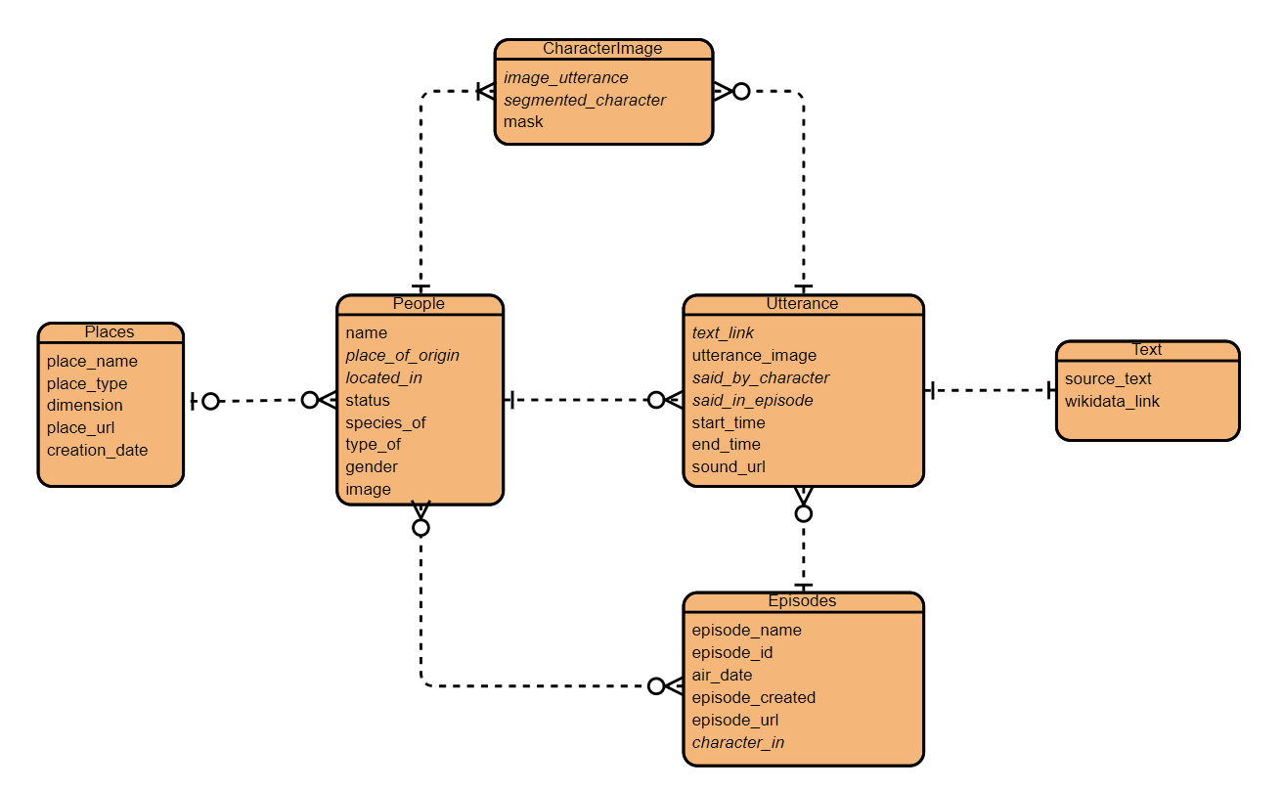
Связь сущностей

Slide 5
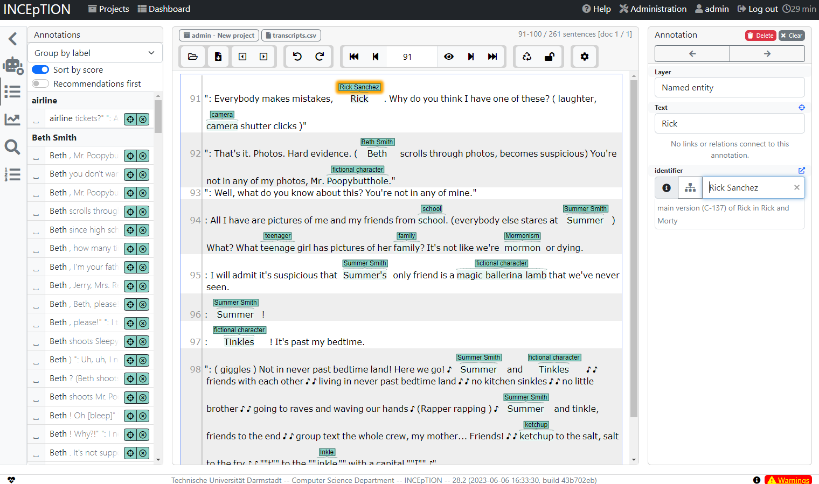
Разметка текстов

Slide 6
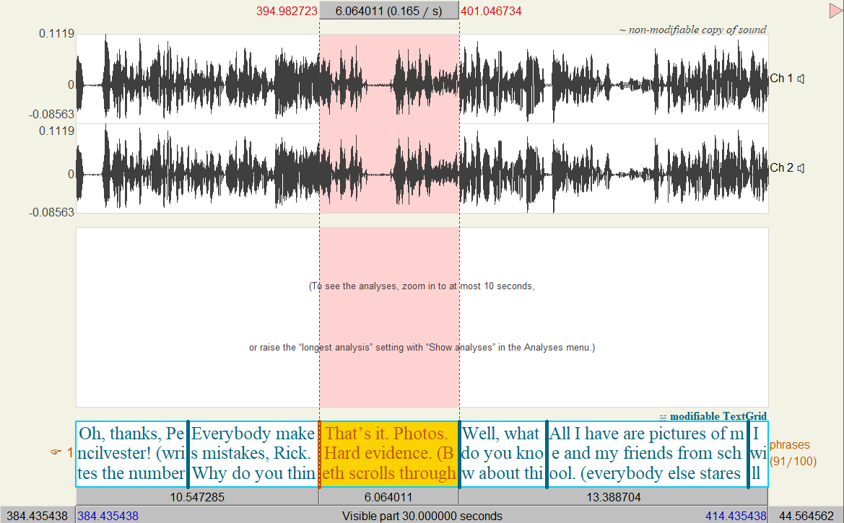
Разметка аудио

Slide 7
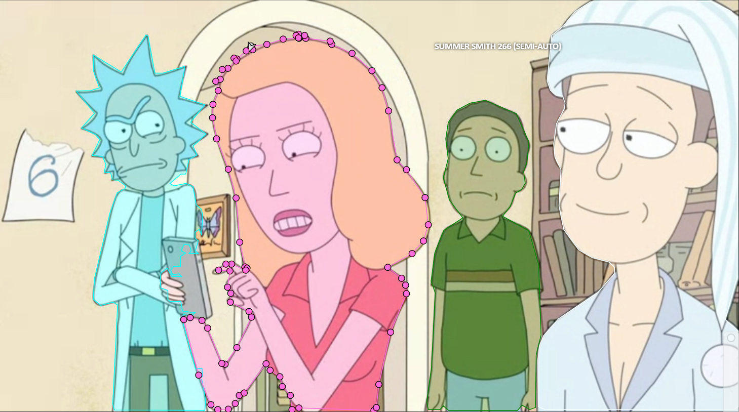
Разметка изображений

Slide 8
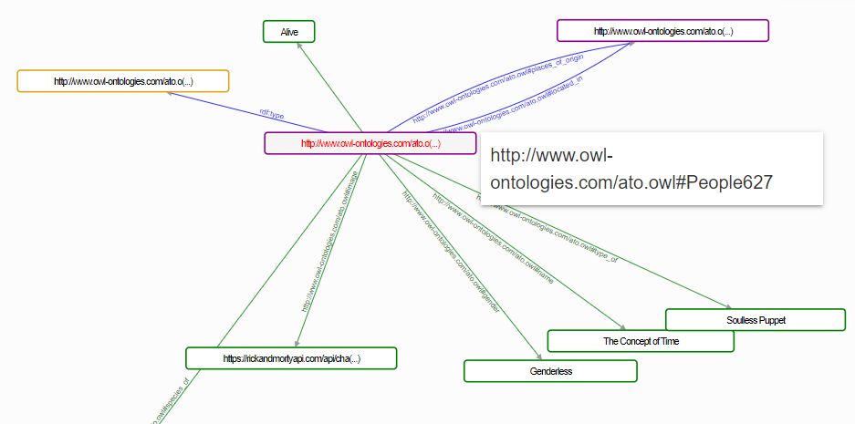
Маааааленький кусочек графа

Slide 9
Реплики Морти
PREFIX foaf: <https://w3id.org/d2s/graph/RickAndMorty#>
SELECT ?text
WHERE {
?x foaf:said_by_character ?s_ch .
?x foaf:said_in_episode ?ep .
?x foaf:text_link ?t_link .
?ep foaf:episode_id ?ep_id .
?s_ch foaf:name ?name .
?t_link foaf:source_text ?text .
FILTER(?ep_id = '15' && ?name = 'Morty Smith')
}
Thanks Uncle Steve!
What the hell, Rick? What the hell?
Steve wasn't real?
But Uncle Steve taught me how to ride a bike.
Why did all the drinks have to be extra large? Oh, the hulk. I just got that.
Come on, cousin Nicky. You heard Rick. We have to stay quarantined until we know that there's no more of these things.
What the...? Cousin Nicky was a parasite?!
This is the last time I ask you for help on my history final, Rick.
I don't want to go to the dance alone.
We shall.

Slide 10
Ссылки в репликах Морти
PREFIX foaf: <https://w3id.org/d2s/graph/RickAndMorty#>
SELECT ?wiki_link
WHERE {
?x foaf:said_by_character ?s_ch .
?x foaf:said_in_episode ?ep .
?x foaf:text_link ?t_link .
?ep foaf:episode_id ?ep_id .
?s_ch foaf:name ?name .
?t_link foaf:source_text ?text .
?t_link foaf:wikidata_url ?wiki_link
FILTER(?ep_id = '15' && ?name = 'Morty Smith')
}
http://www.wikidata.org/entity/Q95074
http://www.wikidata.org/entity/Q24207815
http://www.wikidata.org/entity/Q95074
http://www.wikidata.org/entity/Q95074
http://www.wikidata.org/entity/Q5935752
http://www.wikidata.org/entity/Q95074
http://www.wikidata.org/entity/Q24207815
http://www.wikidata.org/entity/Q95074
http://www.wikidata.org/entity/Q24207815

Slide 11
Персонажи в кадре реплики
PREFIX foaf: <https://w3id.org/d2s/graph/RickAndMorty#>
SELECT ?name ?speaker_name ?text
WHERE {
?x foaf:image_utterance ?utt .
?utt foaf:said_in_episode ?ep .
?ep foaf:episode_id ?ep_id .
?x foaf:segmented_character ?seg_ch .
?seg_ch foaf:name ?name .
?utt foaf:text_link ?t_link .
?utt foaf:said_by_character ?speaker_ch .
?speaker_ch foaf:name ?speaker_name .
?t_link foaf:source_text ?text .
FILTER(?ep_id = '15' && ?text = ': Best uncle ever!')
}
Jerry Smith is in the frame when Summer Smith says : Best uncle ever!
Beth Smith is in the frame when Summer Smith says : Best uncle ever!
Summer Smith is in the frame when Summer Smith says : Best uncle ever!
Morty Smith is in the frame when Summer Smith says : Best uncle ever!
Uncle Steve is in the frame when Summer Smith says : Best uncle ever!

Slide 12




